Slide 1



Data Analysis and Sales Forecasting of Walmart's Retail Data using PySpark and Machine Learning
Notes:
slidesppt.net

Slide 2

Team 39
Guided By
Kiran Thorat (240343025022)
Manu Singh (240343025025)
Payal Jadhav (240343025034)
Shubham Mule (240343025056)
Mrs. Trupti Joshi
Mr. Prasad Deshmukh

Slide 3
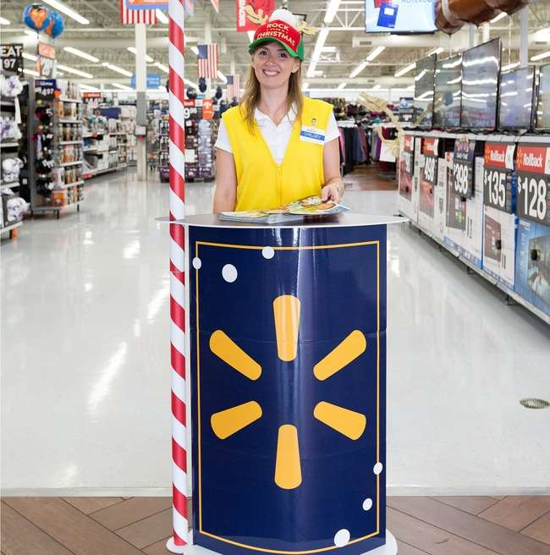

Introduction
01
To Analyze Walmart retail Data for insights and Trends
02
To build forecasting models using Machine learning techniques.
Scope
03
Sales data analysis
04
Demand forecasting
Notes:
slidesppt.net

Slide 4
Problem Statement
Sales Analysis: How can we effectively analyze Walmart's historical sales data to identify key trends and patterns that drive business performance and inform decision-making?
Sales Prediction: How can we accurately forecast Walmart's future sales using historical data, accounting for factors like seasonality and promotions, to optimize inventory and pricing strategies?

Slide 5







ARCHITECTURE
Data collection
Data pre-processing
Exploratory data
analysis
Predictions &
Deployment
Data Visualization
Model Training
Clean Data

Slide 6

DATA PRE-PROCESSING
Dropping Irrelevant Columns
Handling Missing Values
Converting Data Types

Slide 7

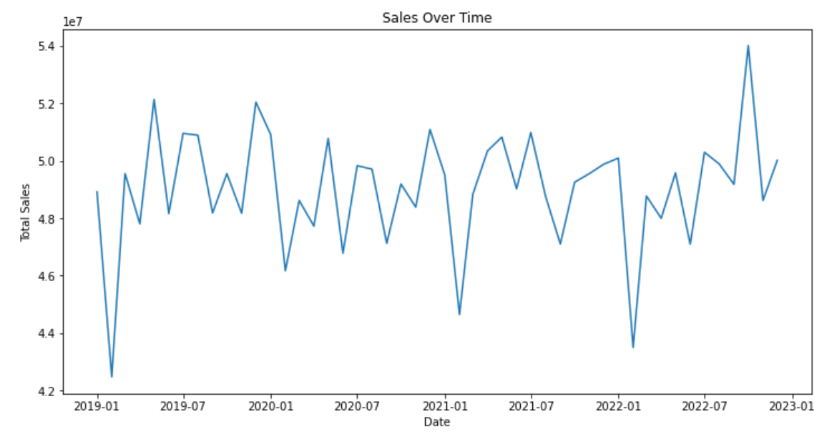
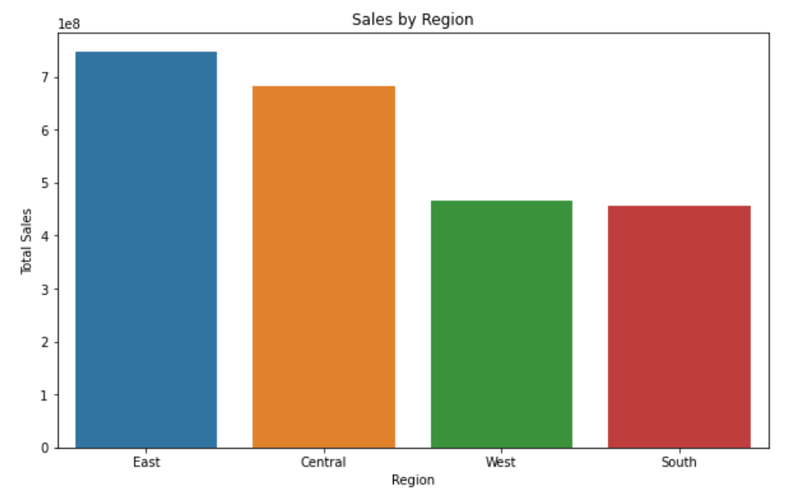
Exploratory Data Analysis (EDA)
Sales over Month & Year
Sales by Region

Slide 8

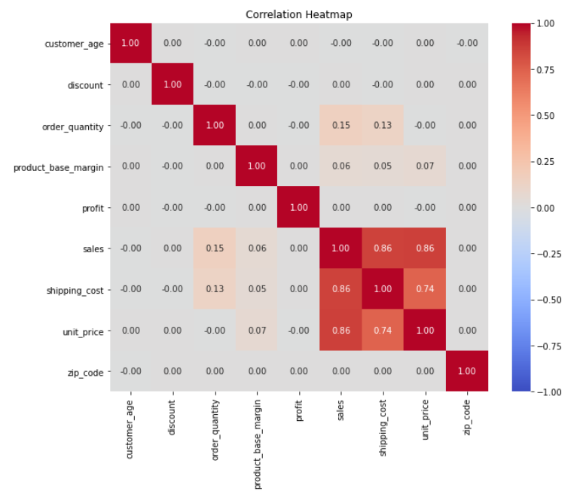
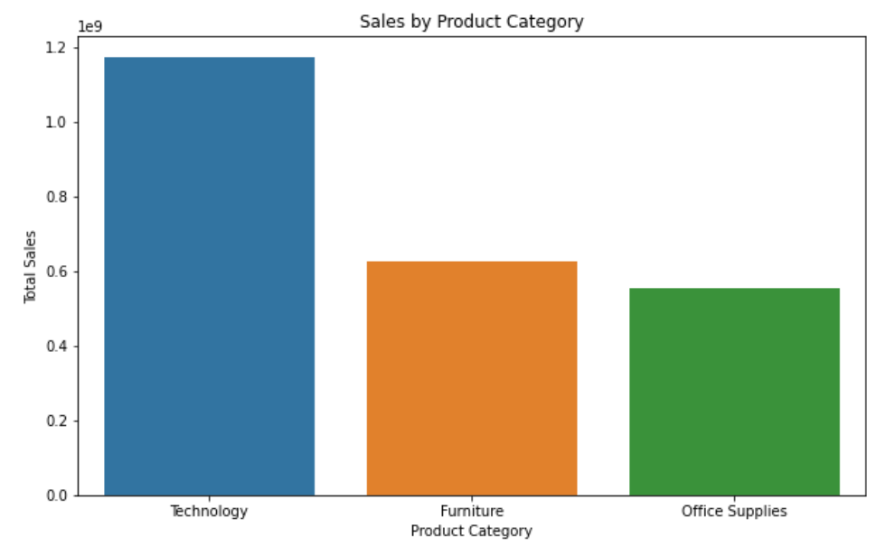
EDA
Sales by Product Category
Correlation Heatmap

Slide 9

ML MODEL
Model Selection: Prophet Model, ARIMA (Auto-Regressive Integrated Moving Average) and SARIMA (Seasonal Auto-Regressive Integrated Moving Average) Model.
Why These Models ?
Predictive Accuracy
Seasonality Handling
Scalable

Slide 10


Outlier Handling : Outliers were replaced by respective upper and lower bound.
Parameter Tuning: Conducted extensive parameter tuning, including selecting the optimal p (autoregressive order), d (differencing order), and q (moving average order) parameters, to improve the model's accuracy in predicting future sales.
Regressor adjustment Based on cross-validation results of Prophet models.
Model Evaluation:
Root Mean Square Error (RMSE).
Mean Absolute Percentage Error (MAPE)
Median Absolute Percentage Error (MDAPE)
Coverage

Slide 11

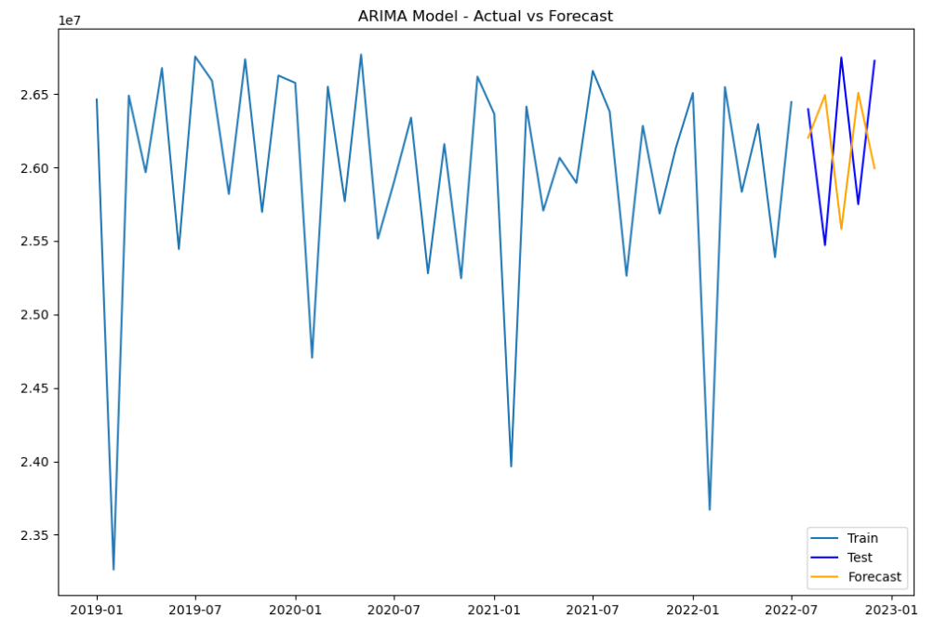
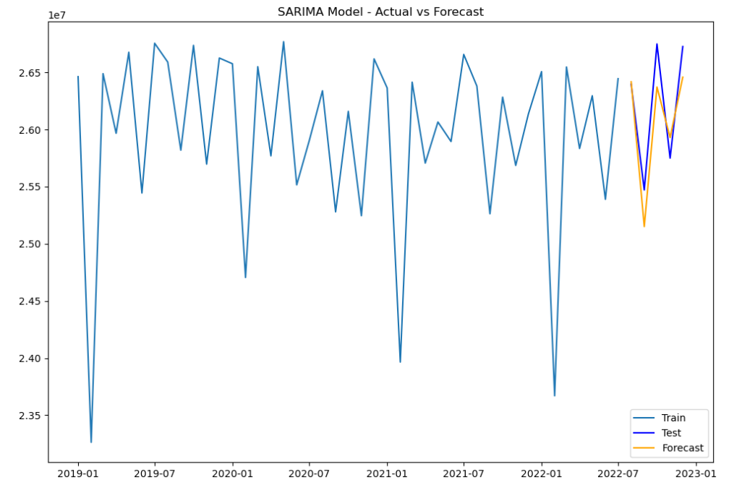
Results and Insights
Arima Model
Sarima Model

Slide 12

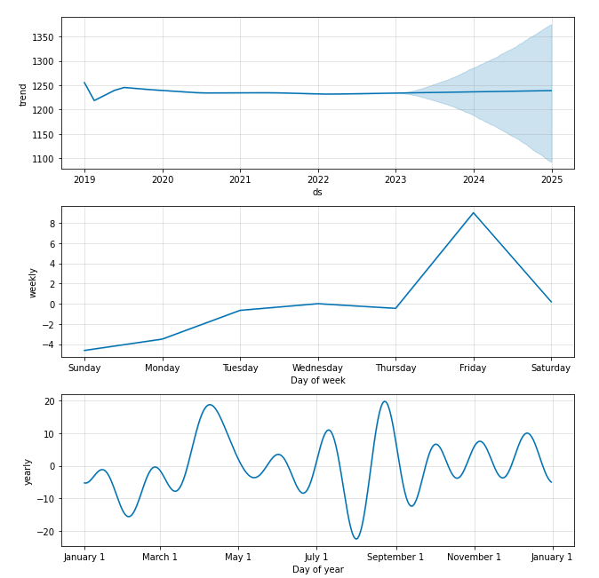
Prophet Model

Slide 13

Successful analysis and forecasting of sales data.
Potential for business application in real-world retail scenarios.

Slide 14

Future Scope
Deployment of the model in a real-time environment.
Enhancements with additional data sources.

Slide 15




Thank You

